Slide 1
CSE428: Image Processing
Lecture 6

Slide 2
Neighbourhood processing: Part 1

Slide 3
Contents
Spatial operations
Neighborhood operations
Spatial filtering
Image padding
Linear spatial filtering
Correlation and convolution
Smoothing spatial filters: Gaussian, Average & Median filtering
Unsharp masking & high boost filtering
Geometric transformations

Slide 4
Spatial Operations
Can be subdivided into 3 broad categories:
Single-pixel operations or point processing (covered in the last lecture)
Neighborhood operations or neighborhood processing
Geometric spatial transformations (won’t go into too much detail)

Slide 5
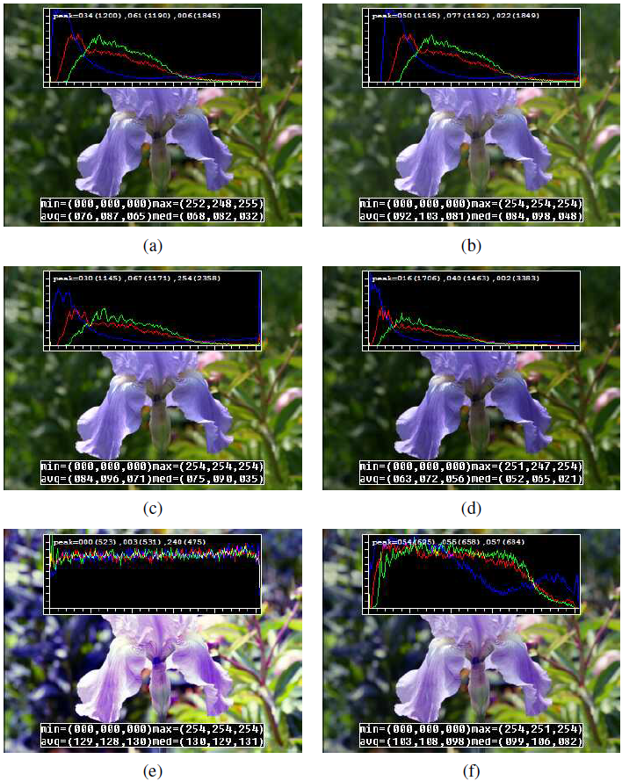
Single-pixel operations
Simplest possible operation on an digital image: alter the pixel intensities
If T is a transfer function, s = T(z) or
z -> original image pixel intensity s -> mapped intensity
Some local image processing operations:
(a) original image along with its three color histograms;
(b) brightness increased (additive offset, b = 16);
(c) contrast increased (multiplicative gain, a = 1:1);
(d) gamma (partially) linearized ( 𝛾 = 1:2);
(e) full histogram equalization;
(f) partial histogram equalization
Computer Vision: Algorithms and Applications, 2nd Edition, Richard Szeliski

Slide 6
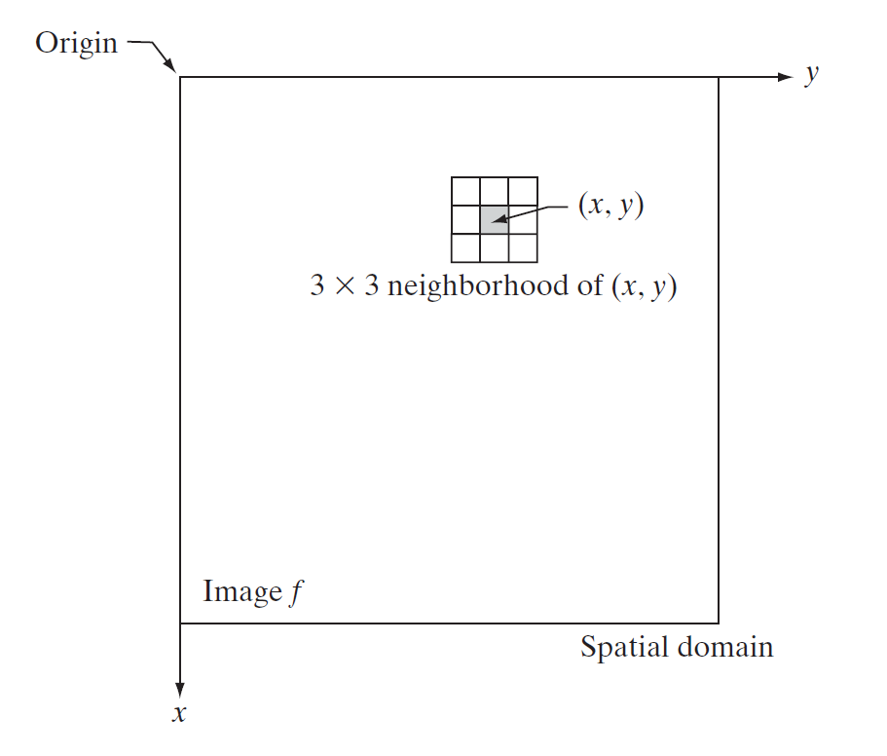
Neighborhood
A pixel p at coordinates has four horizontal and vertical neighbors whose coordinates are given by
(x + 1, y), (x - 1, y), (x, y + 1), (x, y - 1)
This set of pixels, called the 4-neighbors of p, N₄(p)
The four diagonal neighbors of p
(x + 1, y + 1), (x + 1, y - 1), (x - 1, y + 1), (x - 1, y - 1)
Diagonal neighbors of p, N_{D}(p)
4-neighbors together with the diagonal neighbors are called the 8-neighbors of p: N₈(p)
Digital Image Processing, Third Edition, Rafael C. Gonzalez & Richard E. Woods

Slide 7
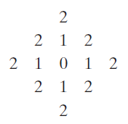
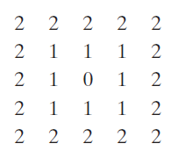
Distance measures
For pixels p, q, and z, with coordinates (x, y), (s, t), and (v, w)
Euclidean distance between p and q
D_{e}(p, q) = [(x - s)² + (y - t)²]^{½}
D₄ distance (city-block distance) between p and q
D₄(p, q) = |x - s| + |y - t|
The pixels with D₄ = 1 are the 4-neighbors of (x, y)
D₈ distance (chessboard distance) between p and q
D₈(p, q) = max(|x - s|, |y - t|)
The pixels with D₈ = 1 are the 8-neighbors of (x, y)
Digital Image Processing, Third Edition, Rafael C. Gonzalez & Richard E. Woods

Slide 8
Linear vs Nonlinear Operations
Consider a general operator, H such that : H [f(x, y)] = g(x, y)
H is said to be a linear operator if the following is true:
H [a₁f₁(x, y) + a₂f₂(x, y)] = a₁H [f₁(x, y)] + a₂H [f₂(x, y)]
Additivity property: output of a linear operation due to the sum of two inputs is the same as performing the operation on the inputs individually and then summing the results
Homogeneity property: the output of a linear operation to a constant times an input is the same as the output of the operation due to the original input multiplied by that constant

Slide 9
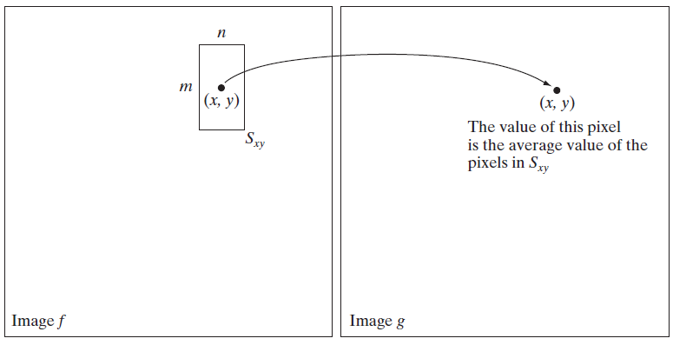
Neighborhood operations
S_{xy} is the set of coordinates of a neighborhood centered on an arbitrary point (x, y) in an image f
Neighborhood processing generates a corresponding pixel at the same coordinates in an output (processed) image, g, such that the value of that pixel is determined by a specified operation involving the pixels in the input image with coordinates in S_{xy}
Digital Image Processing, Third Edition, Rafael C. Gonzalez & Richard E. Woods

Slide 10
Neighborhood operations: Mechanism
Spatial filtering consists of
A neighborhood (defined by the filter kernel, or mask)
A predefined operation (which is performed on the neighborhood)
Linear operation
Nonlinear operation
Filtering creates a new pixel at the same position of the center of the neighborhood, and whose value is the result of the filtering operation
A processed (filtered) image is generated as the center of the filter visits each pixel in the input image

Slide 11
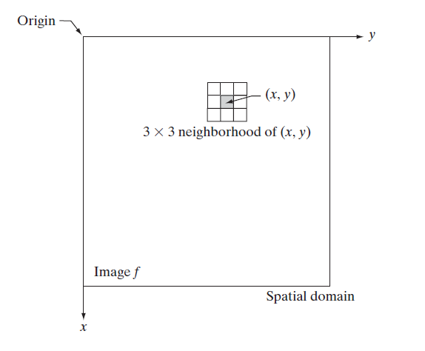
Spatial Filtering
Neighborhood processing is also called spatial filtering
g(x, y) = T [f(x, y)]
Input image: f(x, y)
Output image: g(x, y)
T [ . ] is an operator in f, defined over a neighborhood
Linear operation -> linear spatial filtering
Nonlinear operation -> nonlinear spatial filtering
T can be applied to a single image or multiple images
Example: a 3x3 neighborhood of (x, y)
Digital Image Processing, Third Edition, Rafael C. Gonzalez & Richard E. Woods

Slide 12
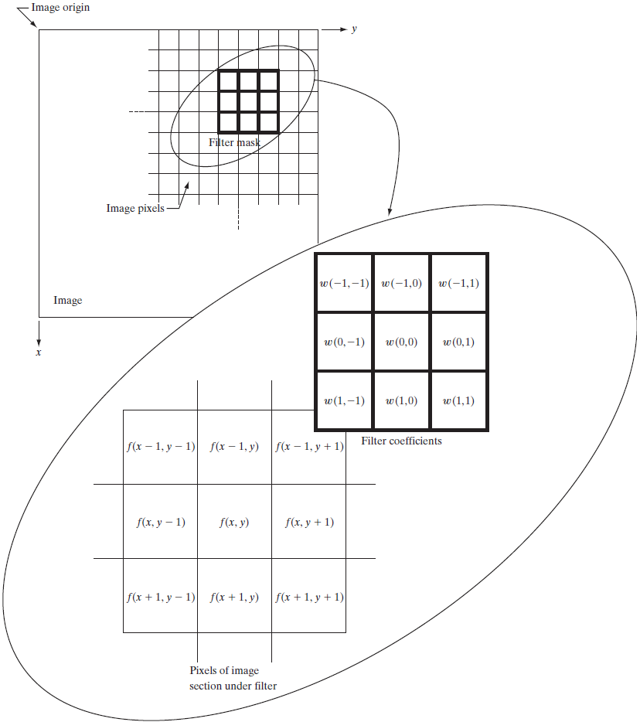
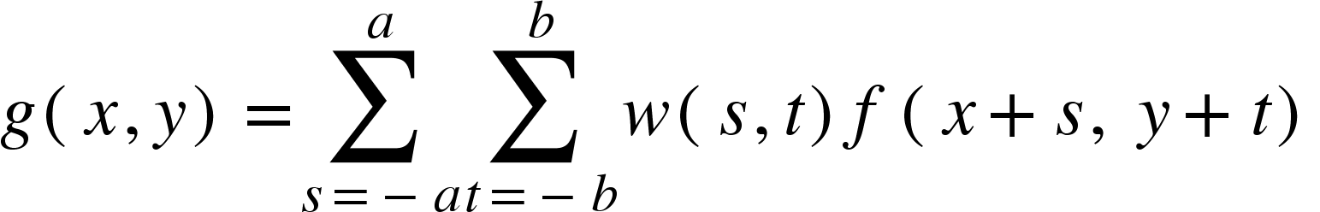
Linear Spatial Filtering
Linear spatial filtering in a m x n neighborhood
Mask/filter/kernel size: m x n
Assume m = 2a + 1, n = 2b + 1 (both odd numbers)
Image size: M x N
Example: g(x, y) = w(-1, -1) f(x-1, y-1) + w(-1, 0) f(x -1, y) + … + w(0, 0) f(x, y) + ... + w(1, 1) f(x+1, y+1)
Digital Image Processing, Third Edition, Rafael C. Gonzalez & Richard E. Woods

Slide 13
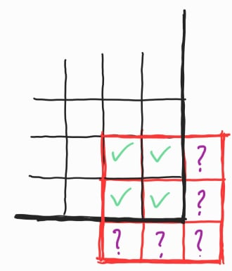
But.. what about the border pixels?

Slide 14
Solution 1: Don’t visit the border pixels!
Result: Image is shrinked

Slide 15
Solution 2: *Padding*
Result: Image shape stays the same

Slide 16
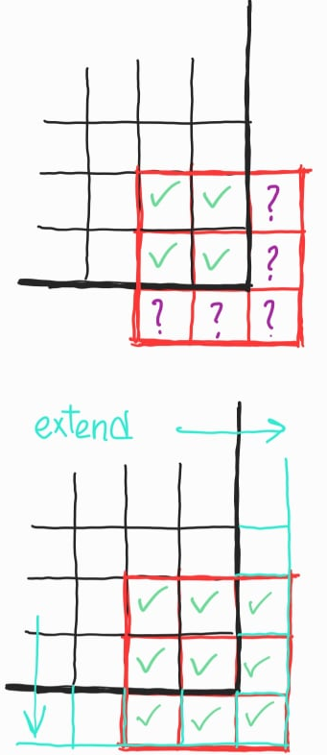
Image Padding
Zero padding: extend the borders of the original image with zeros
Constant padding: extend the borders of the original image with a constant pixel value
Mirror padding: extend the borders of the original image by reflecting the edge pixels
Clamp/Edge/Nearest padding: extend the borders of the original image by repeating edge pixels
More ways: https://scikit-image.org/docs/dev/api/skimage.util.html#skimage.util.pad

Slide 17
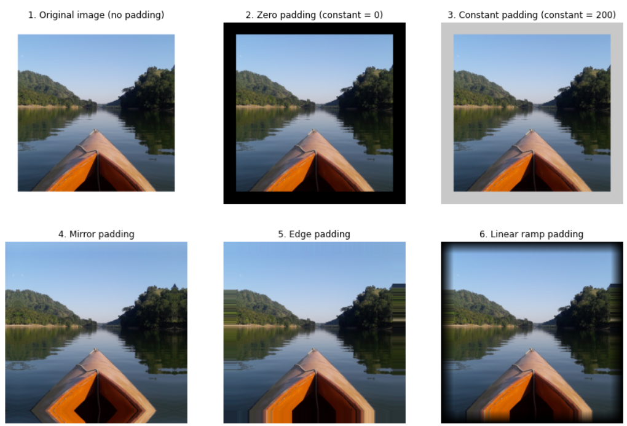
Image Padding
A 1448x1448x3 image padded with 200 pixels on each side:
Original image
Zero padding
Constant padding
Mirror padding
Edge padding
Linear(ramp) padding

Slide 18
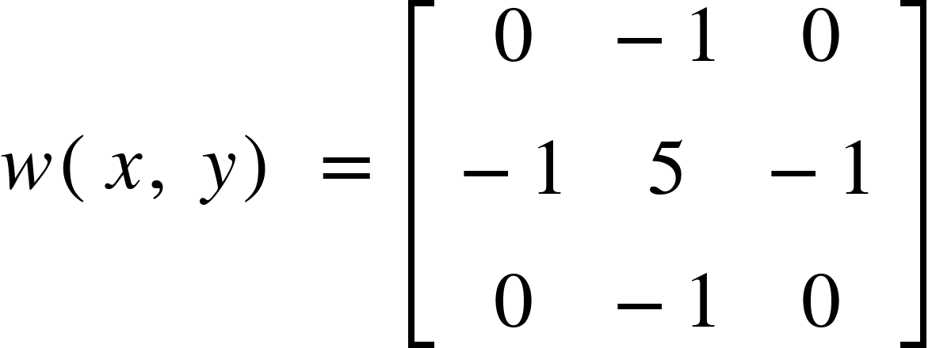
Linear Spatial Filtering: Demo
Kernel shape: 3x3
Input image shape: 6x6
Output image shape: 6x6
Padding: Nearest
Step (stride): 1
Kernel,
https://commons.wikimedia.org/wiki/File:2D_Convolution_Animation.gif

Slide 19
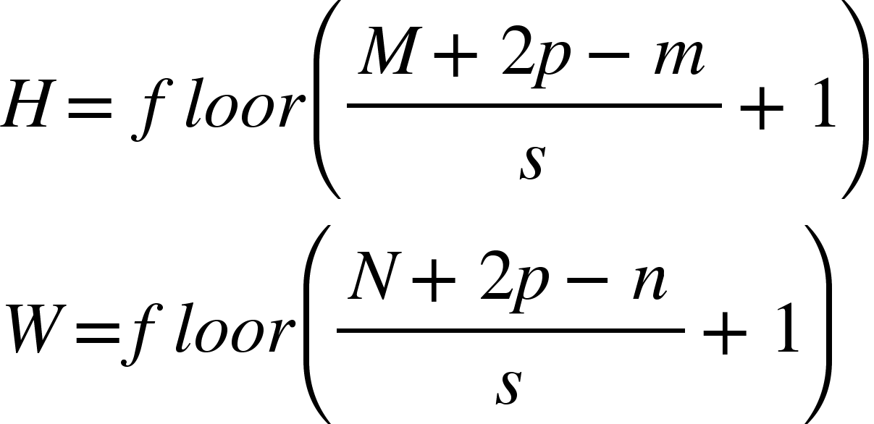
Linear Spatial Filtering: Output Shape
Kernel shape: m x n
Input image shape: M x N
Number of pixels padded: p
Stride: s
Output image shape: H x W
https://commons.wikimedia.org/wiki/File:2D_Convolution_Animation.gif

Slide 20
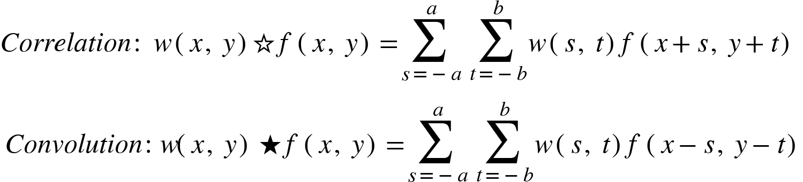
Correlation
Correlation between two 2D signals w(x, y) & f(x, y) is defined as:
Outputs a measure of similarity of the two signals as a function of the displacement of one relative to the other
Also called the cross-correlation
Basically a sliding dot product (vector element wise multiplication)
Used for searching a long signal [f(x, y)] for a shorter signal [w(x, y)] (a known feature)

Slide 21
Linear spatial filtering ⇔ 2D signal correlation

Slide 22
Correlation to Convolution
Linear spatial filtering is basically a 2D signal correlation operation
If we rotate the original filter w(x, y) 180⁰ and then proceed, it’s called the convolution operation
Mathematically,

Slide 23
For symmetric filters,
convolution and correlation both yield the same result!

Slide 24
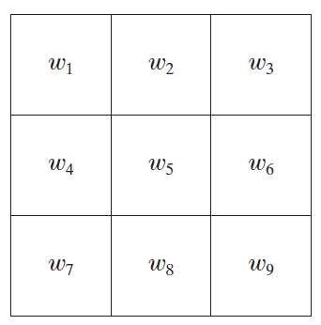
Smoothing Spatial Filters
Linear
Box/average filtering
Gaussian filtering
Non-linear
Median filtering
Example: A 3 x 3 filter with coefficients w₁ through w₉
Digital Image Processing, Third Edition, Rafael C. Gonzalez & Richard E. Woods

Slide 25
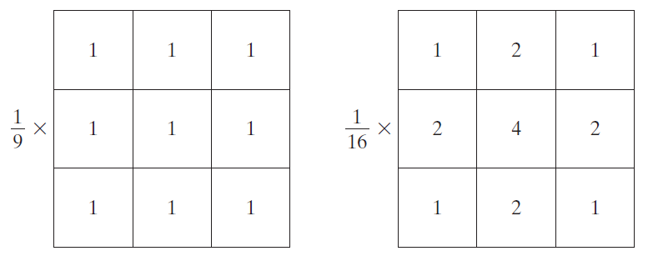
Linear Smoothing Filters
Averaging filter
Average of all the pixels encompassed by the filter kernel
An m x n averaging box kernel: w(x, y) = 1 / m*n
Gaussian filter
Weighted average of all the pixels encompassed by the gaussian filter kernel
An m x n gaussian kernel: w(x, y) = exp(-(x²+y²)/2σ²)
Example: a 3x3 Box filter and a 3x3 Gaussian filter
(note that the filters are normalized so that the intensity of the output pixel remains unchanged)
Digital Image Processing, Third Edition, Rafael C. Gonzalez & Richard E. Woods

Slide 26
Linear Smoothing Filters
Applications
Image Blurring (As the name suggests)
Image Sharpening (wait, sharpening from blurring? what?)
Image Denoising
Low pass filtering (getting rid of high variations)

Slide 27
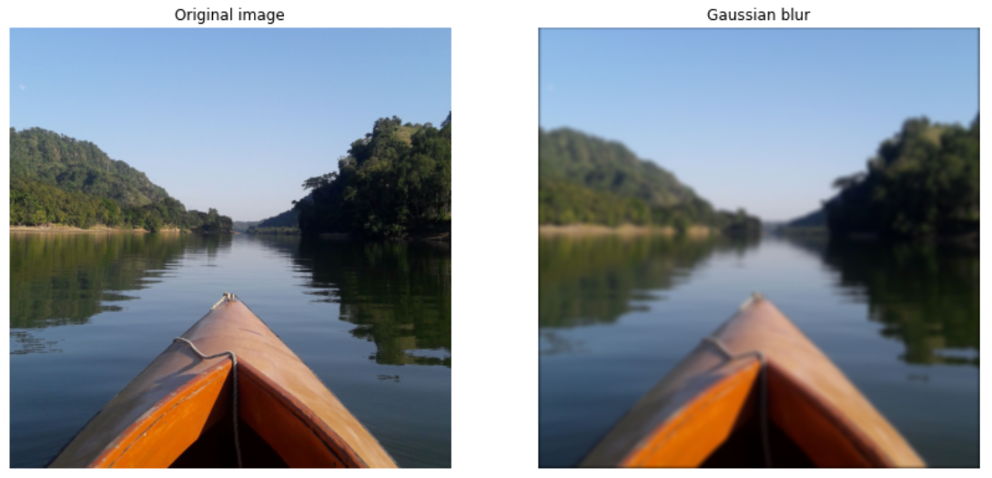
Gaussian Filtering:The Gaussian Blur
Result of filtering an image with with (25 x 25), σ² = 8 Gaussian kernel

Slide 28
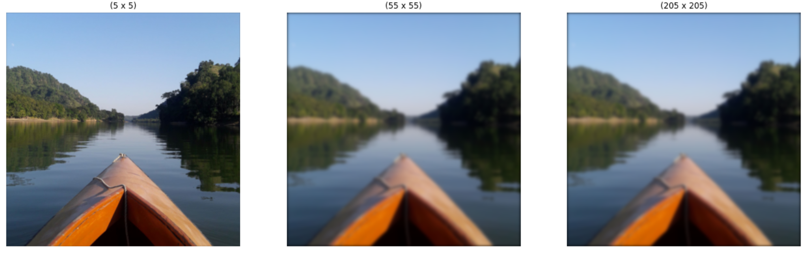
Gaussian Filtering:The Gaussian Blur
Increasing the kernel shape increases blurriness, borders become more prominent

Slide 29
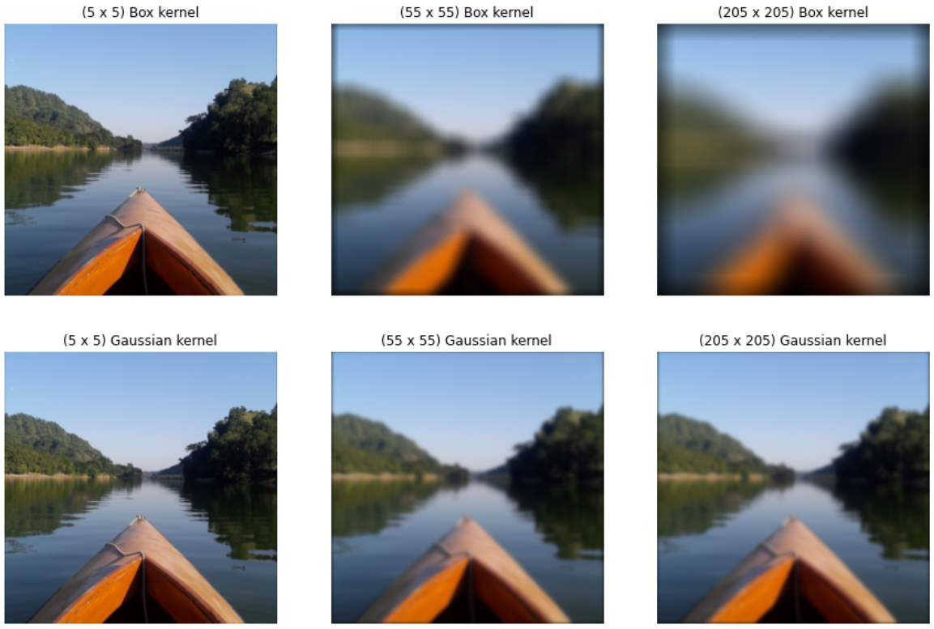
Gaussian Filtering vs Average Filtering
For the same kernel size the gaussian blur preserves more detail of the image
Even though the image is blurred the edges are somewhat better preserved for the gaussian blurring (edge preserving blurring)

Slide 30





Order Statistic Filtering
Response is based on ordering (ranking) the pixels contained in the pixel neighborhood (S_{xy})
Median filtering:
Max and min filtering:
Midpoint filtering:
Alpha-trimmed mean filtering:

Slide 31
Median Filtering
Median Filter (Order-statistic filter)
nonlinear spatial filter
each pixel value is replaced by the median of the intensity values in the neighborhood
excellent noise-reduction capabilities
less blurring than linear filters
particularly effective with impulse noise (salt and pepper noise)

Slide 32


Noise-corrupted Image
< Original image (left)
Noisy image > (right) (Gaussian noise)

Slide 33


Noise Reduction Using Linear Filtering
< Original grayscale image (left)
Noisy image > (right) (Salt and pepper noise, pretty common for old b&w cameras)

Slide 34

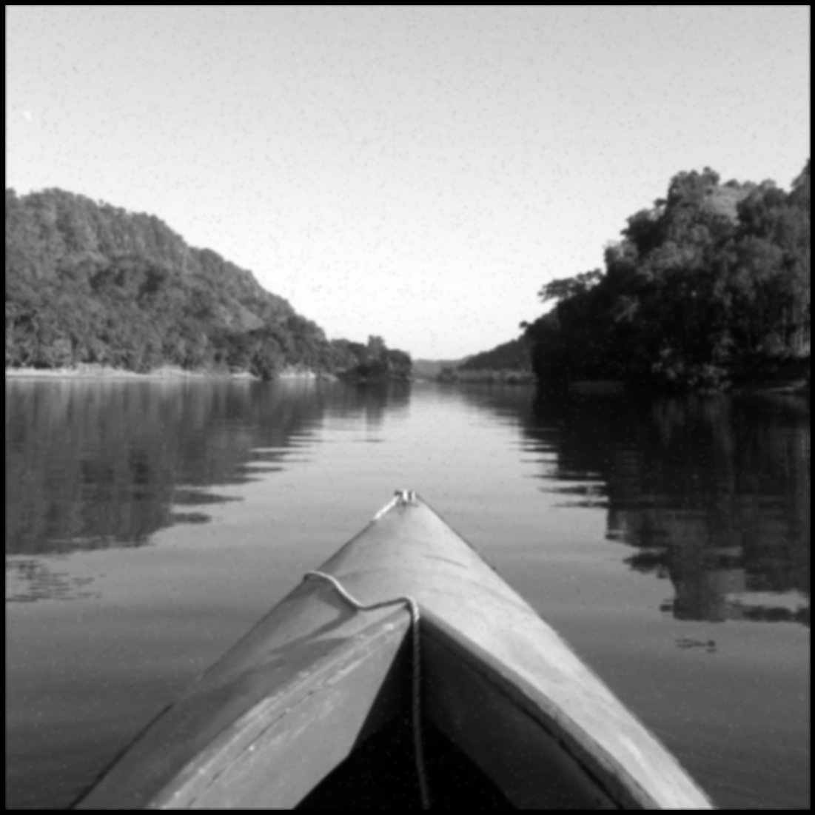
Noise Reduction Using Linear Filtering
Gaussian filter used to denoise both noisy images (25 x 25) σ²=3
Output is blurred, s&p not properly removed

Slide 35

Noise Reduction Using Nonlinear Filtering
Median filter is used to denoise the salt and pepper noise
(can you tell the original from the filtered one?)

Slide 36
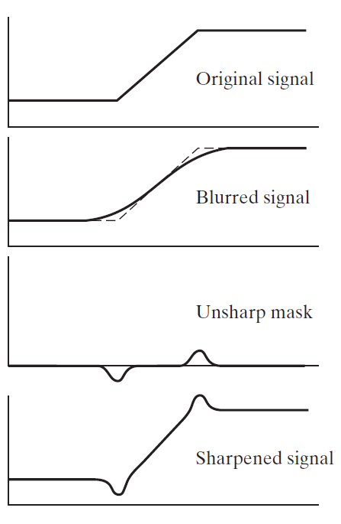
Unsharp Masking & High Boost Filtering
This unsharp masking process consists of the following steps:
Blur the original image
f’(x, y) = Blur[f(x, y)]
Subtract the blurred image from the original (the resulting difference is called the mask)
g_{mask}(x, y) = f(x, y) - f’(x, y)
Add the mask to the original
g(x, y) = f(x, y) + k * g_{mask}(x, y)
k = 1 is unsharp masking, k > 1 is high boost filtering
Digital Image Processing, Third Edition, Rafael C. Gonzalez & Richard E. Woods

Slide 37
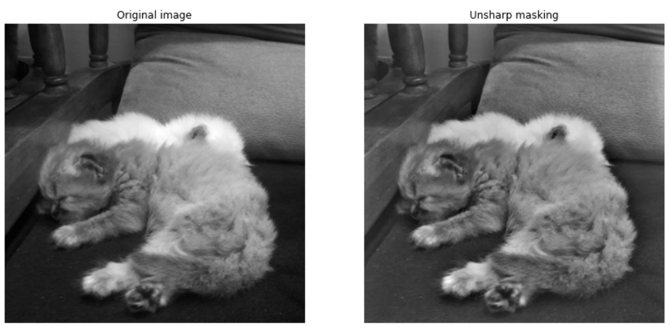
Unsharp Masking

Slide 38
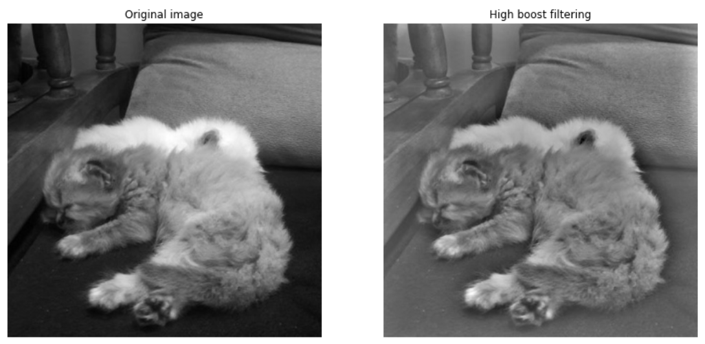
High Boost Filtering

Slide 39
Geometric Transformations
We use geometric transformations modify the spatial arrangement of pixels in an image
These transformations are called rubber-sheet transformations because they may be viewed as analogous to “printing” an image on a rubber sheet, then stretching or shrinking the sheet according to a predefined set of rules

Slide 40
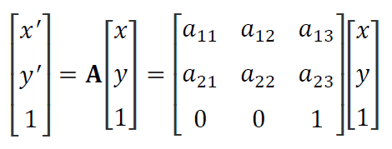
Geometric Transformations
(x, y) are pixel coordinates in the original image
(x’, y’) are the corresponding pixel coordinates of the transformed image
Our interest is in so-called affine transformations, which include scaling, translation, rotation, and shearing
The key characteristic of an affine transformation in 2-D is that it preserves points, straight lines, and planes

Slide 41
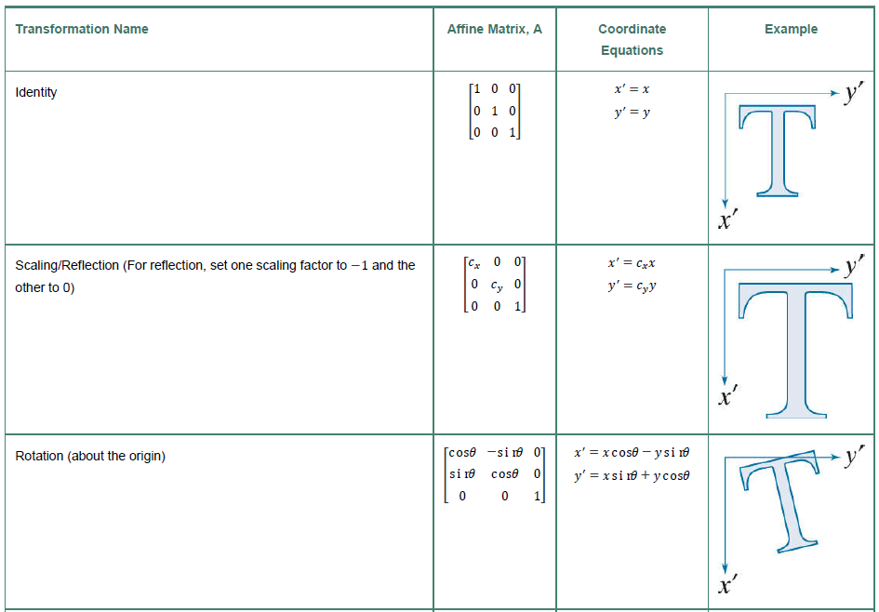
Geometric Transformations
Digital Image Processing, International Edition, Rafael C. Gonzalez & Richard E. Woods

Slide 42
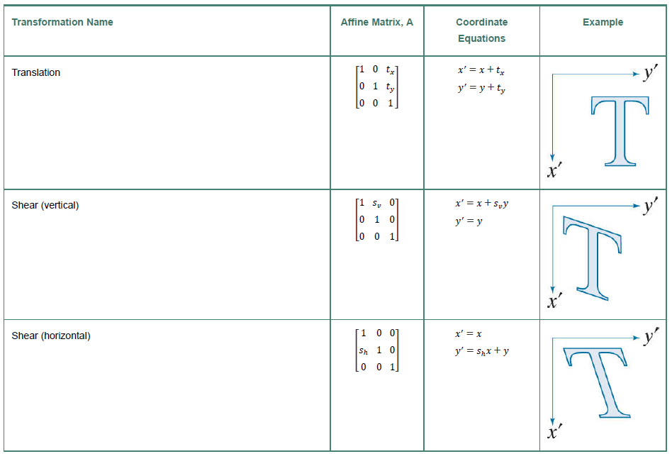
Geometric Transformations
Digital Image Processing, International Edition, Rafael C. Gonzalez & Richard E. Woods

Slide 43
Tutorial
Basic python implementation of some of the algorithms taught in class can be found in the following google colab notebook: https://colab.research.google.com/drive/1JF3ww3l-bBzoC0iy9Ado7eQLcxC1hVFU?usp=sharing

Slide 44
Thank you!

